Slide 1
LLM Alignment: Direct Preference Optimization
Plaban Kumar Bhowmick
Department of AI
plaban@ai.iitkgp.ac.in

Slide 2
Resources
Rafailov et al., Direct Preference Optimization:Your Language Model is Secretly a Reward Model
https://arxiv.org/pdf/2305.18290
Umar Jamil
DPO: https://www.youtube.com/watch?v=hvGa5Mba4c8
Cameron R Wolfe, Direct Preference Optimization (DPO)
https://cameronrwolfe.substack.com/p/direct-preference-optimization
Haitham Bou Ammar, Deriving DPO Loss
https://medium.com/@haitham.bouammar71/deriving-dpos-loss-f332776d6c04

Slide 3
Issues with PPO
Fit a reward model to a dataset of human preferences
RL to optimize a language model policy to produce responses assigned high reward
Addressing reward hacking not to drift excessively far from the original model
An indirect method to train many models
Policy (LM), Reward model, value function model
RL in general is difficult to train
Unstable training
Can we think of a direct method for alignment training?

Slide 4
Direct Preference Optimization (DPO)
Direct preference alignment method
Avoid: Preference data → Reward model → Policy model
Follow: Preference data → Policy model
RL Free training workflow

Slide 5
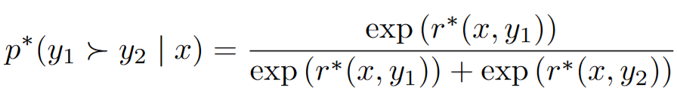


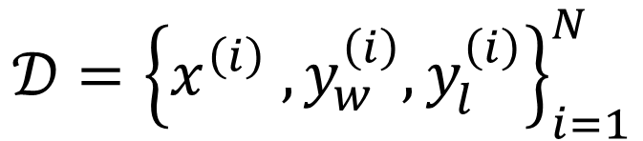

Bradley-Terry (BT) Preference Model
Human Preference Distribution
$$𝒟={\left\{x^{\left(i\right)} ,y_{w}^{\left(i\right)},y_{l}^{\left(i\right)}\right\}}_{i=1}^{N}$$
$$r_{φ}(x,y)$$
$$y_{1}=y_{w}$$
$$y_{2}=y_{l}$$

Slide 6
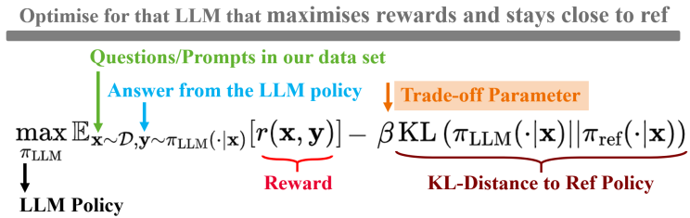
The RL Goal
DPO: Eliminate reward
https://medium.com/@haitham.bouammar71/deriving-dpos-loss-f332776d6c04

Slide 7
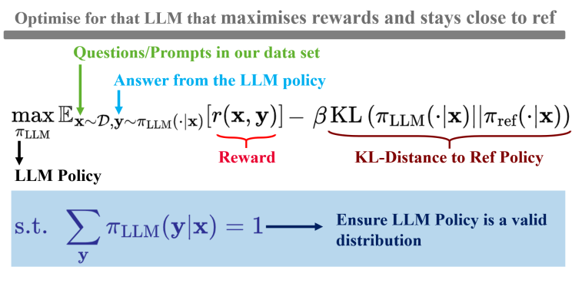
Constrained Optimization Problem
LLM should always be a valid probability distribution

Slide 8
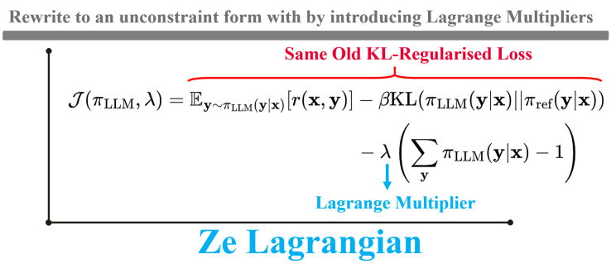
Constrained Optimization Problem
Convert to unconstrained through Lagrangian

Slide 9
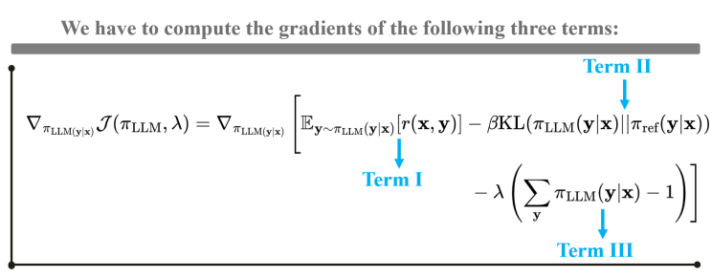
Constrained Optimization Problem

Slide 10
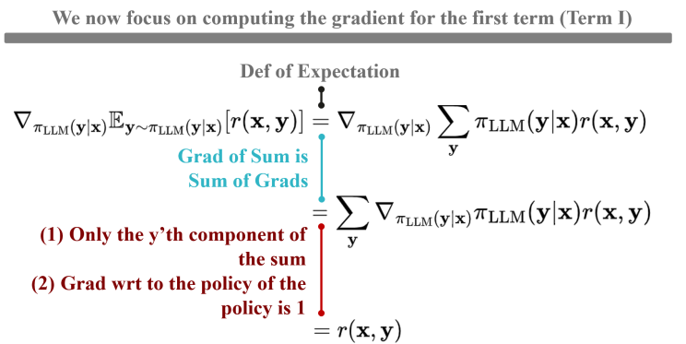
Constrained Optimization Problem

Slide 11
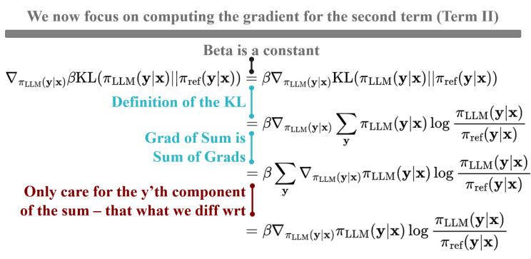
Constrained Optimization Problem

Slide 12
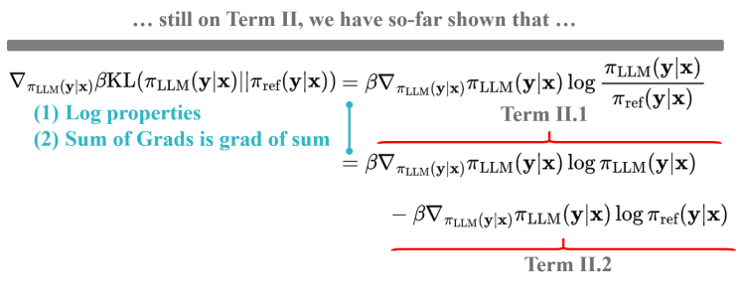
Constrained Optimization Problem

Slide 13
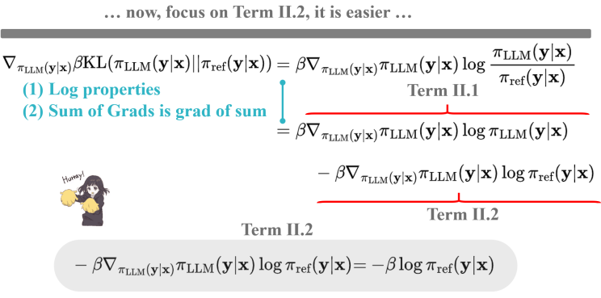
Constrained Optimization Problem

Slide 14
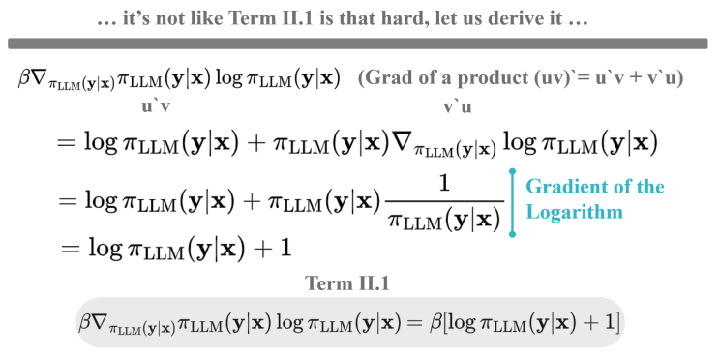
Constrained Optimization Problem

Slide 15
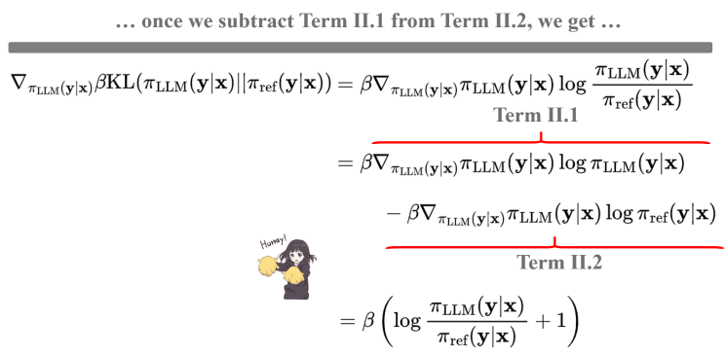
Constrained Optimization Problem

Slide 16
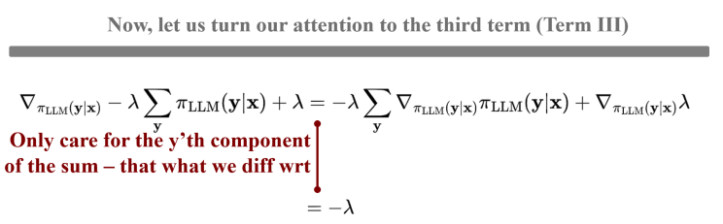
Constrained Optimization Problem

Slide 17
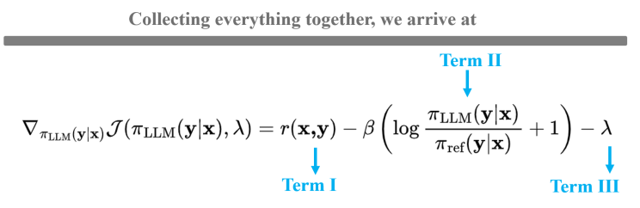

Constrained Optimization Problem

Slide 18
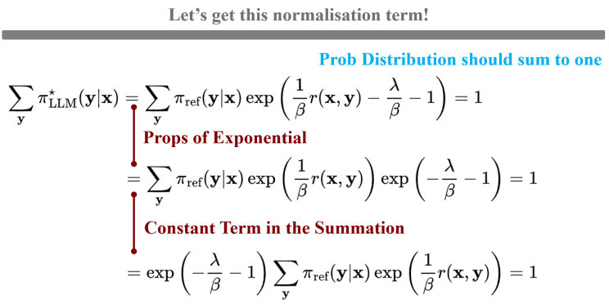
Constrained Optimization Problem

Slide 19
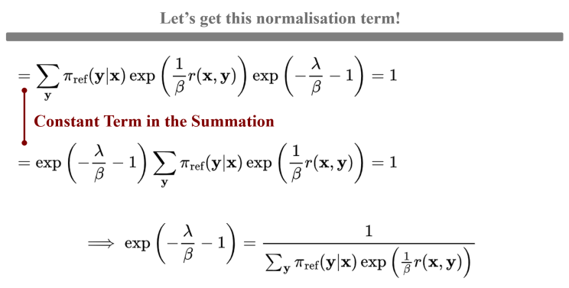
Constrained Optimization Problem

Slide 20
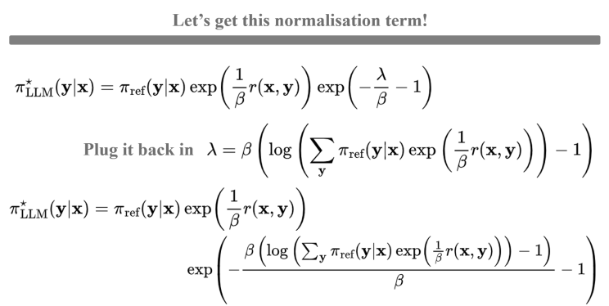
Constrained Optimization Problem

Slide 21
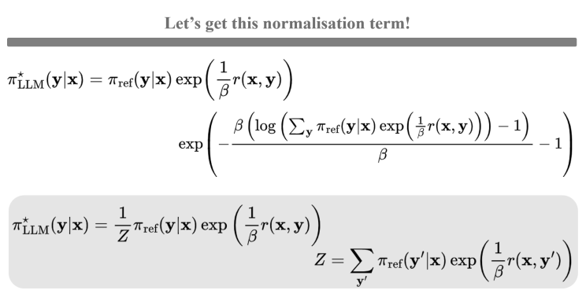
Constrained Optimization Problem

Slide 22
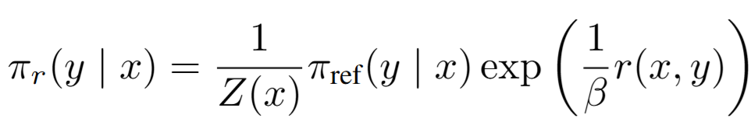
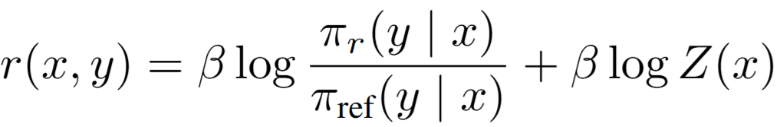
Deriving DPO Objective
It is still expensive to estimate the partition function Z(x)
Implicit reward function:

Slide 23
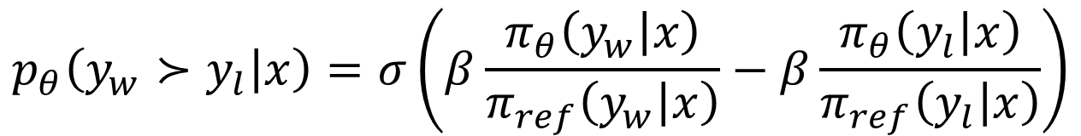
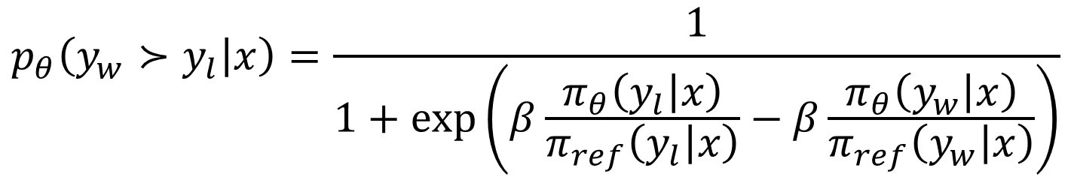
Deriving DPO Objective
Change of variable:
$$p_{θ}\left(y_{w}≻y_{l} | x\right)=\frac{1}{1+\exp\left(β\frac{π_{θ}\left(y_{l} | x\right)}{π_{ref}\left(y_{l} | x\right)}−β\frac{π_{θ}\left(y_{w} | x\right)}{π_{ref}\left(y_{w} | x\right)}\right)}$$
$$p_{θ}\left(y_{w}≻y_{l} | x\right)=σ\left(β\frac{π_{θ}\left(y_{w} | x\right)}{π_{ref}\left(y_{w} | x\right)}−β\frac{π_{θ}\left(y_{l} | x\right)}{π_{ref}\left(y_{l} | x\right)}\right)$$

Slide 24
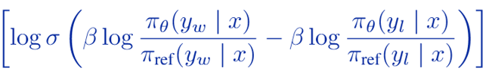



Derivative of DPO Loss
$$−$$
$$(log{π_{θ}\left(y_{w} | x\right)}−\log{π_{ref}(y_{w}|x)) − }(log{π_{θ}\left(y_{l} | x\right)}+\log{π_{ref}(y_{l}|x)) }$$
$$[(log{π_{θ}\left(y_{w} | x\right)}−\log{π_{θ}\left(y_{l} | x\right)]}−[log{π_{ref}(y_{w}|x) }−\log{π_{ref}(y_{l}|x)] }$$
$$u=Δ_{θ}−Δ_{ref}$$
$$ℒ\left(θ\right)=−\log{σ(u)}$$
$$∇_{θ}ℒ\left(θ\right)=(σ\left(u\right)−1)[∇_{θ}log{π_{θ}\left(y_{w} | x\right)}−∇_{θ}\log{π_{θ}\left(y_{l} | x\right)}]$$

Slide 25
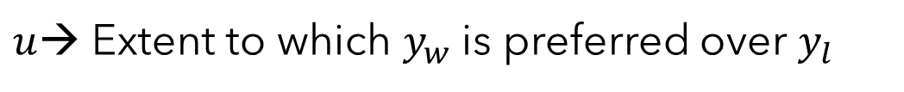
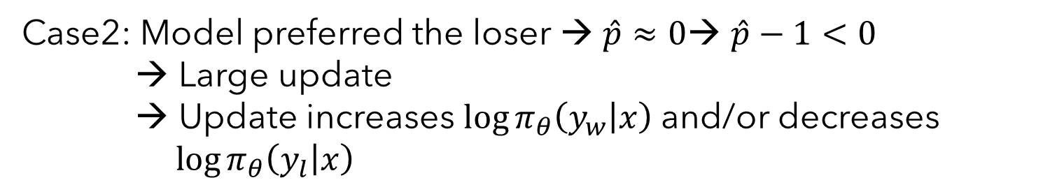
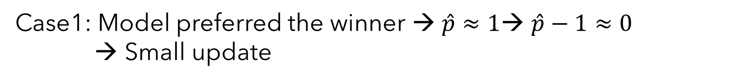
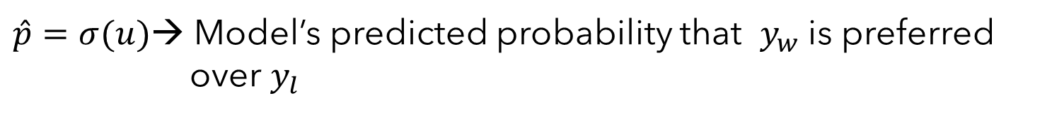
Derivative of DPO Loss
$$∇_{θ}ℒ\left(θ\right)=(σ\left(u\right)−1)[∇_{θ}\log{π_{θ}\left(y_{w} | x\right)}−∇_{θ}\log{π_{θ}\left(y_{l} | x\right)}]$$
$$∇_{θ}ℒ\left(θ\right)=(\hat{p}−1)[∇_{θ}\log{π_{θ}\left(y_{w} | x\right)}−∇_{θ}\log{π_{θ}\left(y_{l} | x\right)}]$$
$u$→ Extent to which $y_{w}$ is preferred over $y_{l}$
$\hat{p}=σ(u)$→ Model’s predicted probability that $y_{w}$ is preferred over $y_{l}$
Case1: Model preferred the winner → $\hat{p}≈1$→ $\hat{p}−1≈0$ → Small update
Case2: Model preferred the loser → $\hat{p}≈0$→ $\hat{p}−1<0$ → Large update
→ Update increases $\log{π_{θ}\left(y_{w} | x\right)}$and/or decreases $\log{π_{θ}\left(y_{l} | x\right)}$

Slide 26
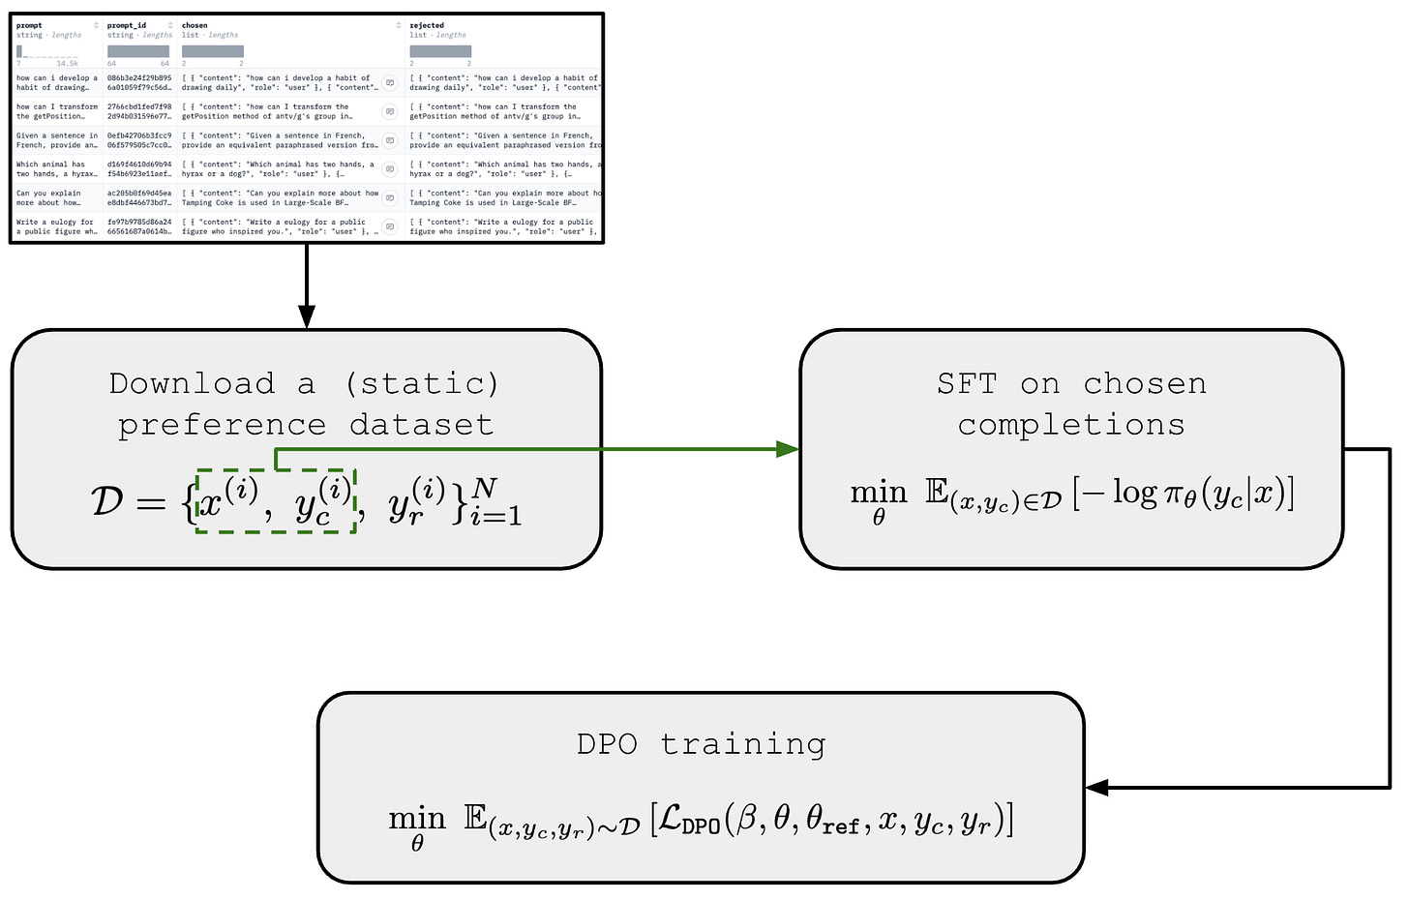


Slide 27
Thank You

